Slide 1

PANAMA LIMITED
EMPLOYEE ATTRITION ANALYSIS
2024

Slide 2

INTRODUCTION
Employee attrition refers to the natural process by which employees leave the workforce – for example, through resignation for personal reasons or retirement – and are not immediately replaced
In this project I’m conducting an Employee Attrition Analysis for Panama Limited Company which is facing high employee turnover. The HR department has provided me with a dataset containing information on employee demographics, job roles and tenure with the company in order to analyze it and identify key factors contributing to employee attrition then provide recommendations to reduce turnover

Slide 3

PROJECT OBJECTIVES
To understand Panama Limited employee demographics
To analyze the employee data to find factors contributing to high attrition in the company
To give recommendations to reduce attrition rate

Slide 4

PROBLEM STATEMENT
What are the factors contributing to employee attrition in Panama Limited?
Which departments, Job titles, Gender, Race, Age and Locations are affected by attrition and what are their attrition rates?
At what ages were the employees hired?
Which departments and job titles have underage employees(below 18years) and how many are they?
What is the attrition rate comparison between underaged employees and normal aged employees?

Slide 5
PROBLEM STATEMENT
What are the departments and job titles with highest retention rates?
What is the average tenure?
How many employees in each job title have a tenure of less than 1 year? What are the issues causing that?
Which current employees have stayed the longest in the company and what departments and job titles are they in? What can we learn from them?
What measures to take to reduce employee attrition?

Slide 6

DATA CLEANING
Imported the Employee Data into MySQL Workbench using the Import Table Wizard for cleaning and analysis.
For data cleaning and standardization I :
Removed duplicates
Checked if any trim is required or misspelt words and Modified
Merged First and Last Name into a new column - Full Name
Modified the Gender Column
Converted data type to date for column Hire_date
Converted data type to date for column Birthdate
Converted data type to date for column Termdate

Slide 7
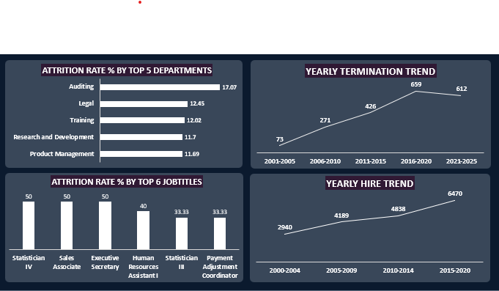
DATA ANALYSIS
I conducted the analysis using SQL and got the following results
Total Number of Employees (22214), Department(13), Job title(184), Race(7)
Auditing Department has the highest attrition rate of 17.07%
Employees who work at the Headquarters have the highest attrition rate of 11.02% as compared to those who work remotely
88% of Employees were above 18 years when hired and 12% were underaged
Employees who joined Panama limited as under-aged (below 18 years) have the highest attrition rate of 13.25% as compared to the normal aged-10.57% This is a high indicator to the company to not hire under-aged employees as it contributes to attrition among other factors.

Slide 8
DATA ANALYSIS
Employees who come from Michigan have the highest attrition rate of 11.72%
Job Titles Statistician IV, Sales Associate and Executive Secretary have the highest attrition rate of 50%
Female gender has the highest attrition rate of 11.35%.
Native Hawaiian or Other Pacific Islander have the highest attrition rate of 14.41%
Marketing department has the highest retention rate of 91.24%
Marketing Manager among other Job titles have 100% retention rate
Average Tenure of Terminated Employees – 7.1 years
Job titles such as Business Analyst have tenure < 1 and Research Assistant II among others have tenure > 23

Slide 9
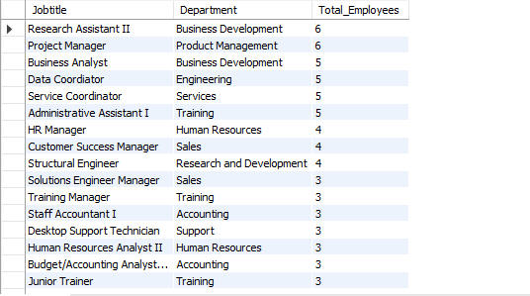
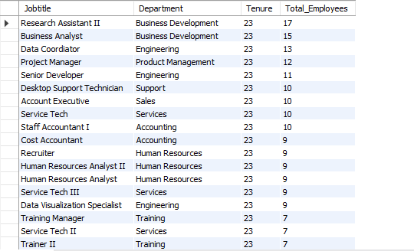
DATA ANALYSIS
JOB TITLES WITH TENURE <1 YEAR
JOB TITLES WITH HIGHEST TENURE >= 23 Years

Slide 10
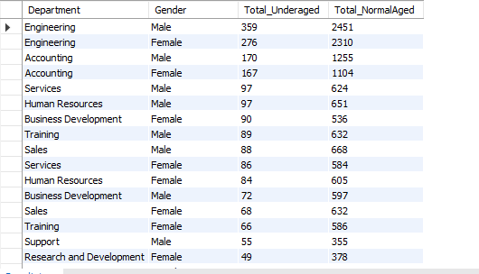
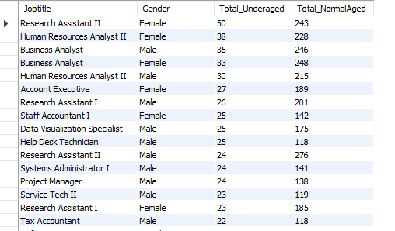
DATA ANALYSIS
DEPARTMENTS WITH UNDER-AGED EMPLOYEES
JOB TITLES WITH UNDER-AGED EMPLOYEES

Slide 11
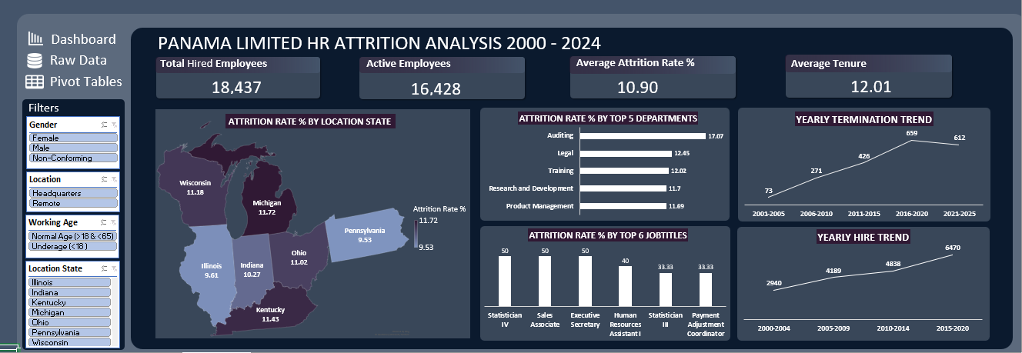
DATA VISUALIZATION

Slide 12

RECOMMENDATIONS
Panama Limited should avoid employing underage employees (below 18 years). This is an issue that could be contributing to the high attrition as the employees are too young to work effectively and also not qualified to meet the job requirements.
The company should look into departments and job titles with high attrition rates and tenure of <1 year and find out what could be causing employees to leave
It should also analyze departments and job titles with high retention rates and tenure of 23 years to get insights as to why they stay. This will help them apply the same strategies to the other departments and job titles especially those with high retention rates
Panama limited should also consider having more remote roles as the analysis showed higher attrition rates among the employees who work at the headquarters

Slide 13
RECOMMENDATIONS
The company should also find out why employees who come from Michigan have the highest attrition rate of 11.72%. Is there an issue from that region that causes that?
The company should also be open to getting job review, satisfaction and rating from the employees. This will help them understand if there are any issues facing the employees and solve them.
Above all, Panama Limited should create a conducive working environment, salary review, recognize employees for their performances, offer training and career development opportunities

Slide 14
THE END
THANK YOU

